Slide 1
DAYDREAMING: EMPIRICAL AND CONCEPTUAL DEVELOPMENTS
Ian R. Newby-Clark, Lauren Holt, Caitlin Duncan, Brianna Wilson

Slide 2
WHY?

Slide 3
Overview
The Goals
Daydream Versus Mind-Wandering
PCF
Problems with Method
Progress!
A Description of Daydreaming Itself

Slide 4
Five Goals
Daydream Content
Attitudes Toward One’s Daydreams
Daydream Frequency
Daydream Duration
Awareness

Slide 5
Daydreaming Versus Mind-Wandering
Mind-Wandering
Thought to Thought
A Daydream (Dorsch, 2015)
Purposiveness
Agency
Narrative Structure
A Daydream is an Imagined Event
Newby-Clark & Thavendran (2018)

Slide 6
A PCF of Daydream
A future event imagined by a person in which the person behaves in a desired way with another person.
T1. Change future event to past event.
T2. Change A future event to An event.
T3. Eliminate with another person.
T4. Change another person to other people.
T5. Change the person to a person.
T6. Change the person to people.
T7. Change in a desired way to in an undesired way.

Slide 7
The Method & Its Problems
Two Stage Process
Thought Recording
Notes and Ratings
AWARE!
No Mind-Wandering

Slide 8
The New Method
Boring Task
Beeped
Notes and Ratings
Mind-Wandering and Daydreaming

Slide 9
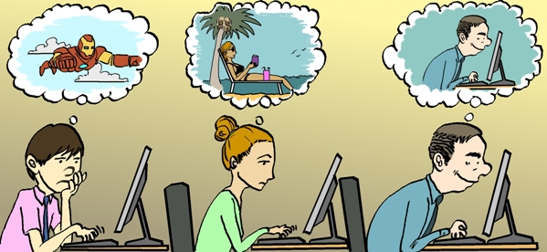
Description of Daydreaming
<B> = <I, W, K, KH, 𝛳, A, PC, S>
<K> = ?
PSPD (Paradigmatic Social Practice Desc.)
<B> = <I, W, K, KH, P, A, PC, S>
<B> = <I, W, K, KH, P, A, PC, S>
<B> = <I, W, K, KH, P, A, PC, S>
𝛳

Slide 10
Thanks!
Christopher Chinn
Caitlin Duncan
Lauren Holt
Talia Rockman
Clarissa Shepherd
Kajalaxy Thavendran
Brianna Wilson
Jesse Windsor

Slide 11
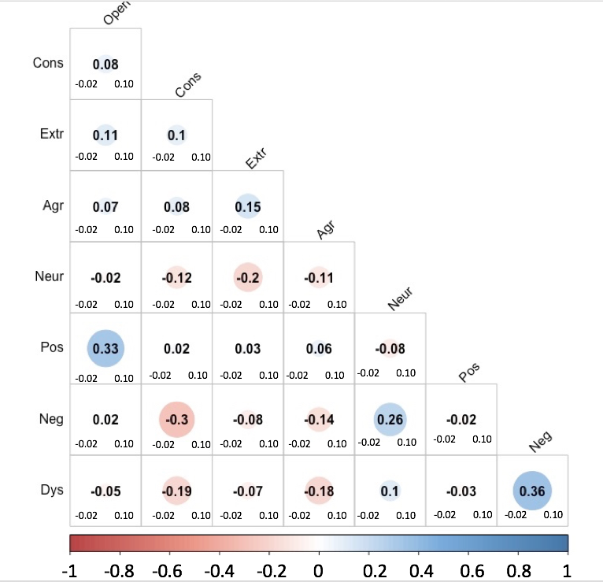
Attitudes Toward One’s Daydreams

